Slide 1
Vital Signs: Range
Age | Awake HR | Sleeping HR | Resp. Rate
0-3 months | 85-205 | 80-160 | 30-60
3 months-2 yrs. | 100-190 | 75-160 | 24-40
2-10 yrs. | 60-140 | 60-90 | 18-30
>10 yrs. | 60-100 | 50-90 | 12-16

Slide 2
Blood Pressure
Age | Minimum sBP (mmHG)
0-30 days | 60
1 month- 1 year | 70
1-10 years | 70 + 2x age (in years)
>10 years | 90

Slide 3
Fluid Resuscitation:
20 mL/kg/hr.
Maintenance:
10 mL/kg/hr.

Slide 4
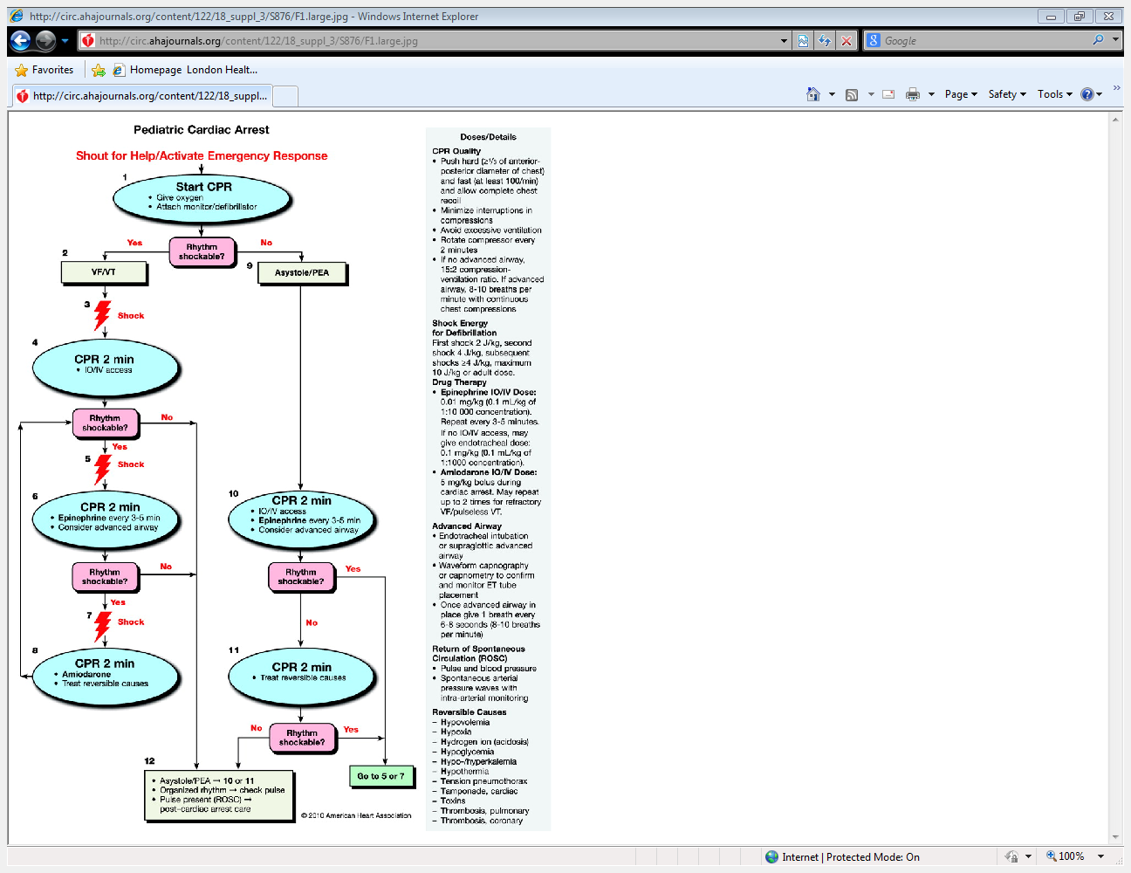

Slide 5
Medications
Epinephrine 1:10,000 – 0.1mL/kg (0.01mg/kg)
Repeat every 3-5 minutes
Amiodarone – 5 mg/kg bolus during cardiac arrest
in patient with shockable rhythm
Atropine – 0.02mg/kg for primary AV block or
increased vagal tone in patient with bradycardia
and poor perfusion

Slide 6
H’s and 5T’s
H’s
T’s
Hypovolemia
Hypoxia
Hydrogen ion
Hypo/hyperkalemia
Hypothermia
Hypoglycemia
Tension pneumothorax
Tamponade
Toxins
Thrombosis (cardiac)
Thrombosis (pulmonary)

